Slide 1
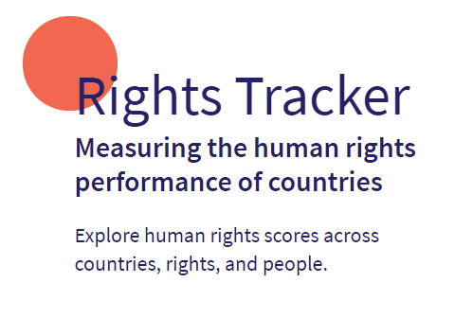
HRMI Calculator & RightsTracker.org (2024 version)

Slide 2
Economic, Social and Cultural Rights
For a nation’s people to flourish its GOVERNMENT must respect, protect, and fulfill HUMAN RIGHTS.
Food
Housing
Civil & Political Rights
Health
Calculator FOCUS: The International Covenant for Economic, Social and Cultural Rights (ICESCR):
ratified by virtually all nations
includes the rights to Food, Health, Education, Work, & Housing.
Education
Work
recognizes that many nations lack the resources to completely meet these obligations, but…...
the government must “…to the maximum of its available resources … progressively..” fulfill these rights.
The calculator uses the “SERF Index” & its implementation of this progressive realization clause

Slide 3
The RightsTracker.org website measures how well a country’s government is meeting its obligations in these five areas of economic and social rights (ESR).
The government’s performance in each area is measured on a scale
Each scale can range from 0% to 100%
Quality of Life
0%
100%
0% means the government is not doing anything to supplement natural economic and social processes
100% means the government is doing the best it can given its resources
0%
100%
0%
100%
Food
Housing
Health
0%
100%
The scores in these 5 areas are averaged into a “Quality of Life” score
Education
Work
0%
100%
How are the scores in each right area calculated? (The calculator is essential in the initial stages.)
0%
100%

Slide 4
How the Right to Health score is constructed - 1.
Right to Health is the average of three “adjusted” indicator scores.
Child survival rate
Adult survival rate
% newborns not low birth weight
Use the “child survival” indicator to illustrate the adjustment process (done by the calculator).
The “raw” indicator value is the percent of newborns who survive to age 5 or better. Let’s say it is 80% for a country.
100%
The government cannot take credit for all of this 80% because in societies without much government input 68% of the newborns live to age 5 or better.
This is the “natural minimum” for this indicator.
80%
Food
68%
Housing
Health
Education
0%
Work

Slide 5
Some countries cannot be expected to reach 100% on this indicator because they do not have enough resources to do so.
HRMI uses the GDP/capita as a measure of the resources a country has available. Assume this country has $1,100/capita, which is very little.
The calculator provides an “income-adjusted benchmark” that the country could reach with its available resources. This is 95% for this country and this indicator.
How the Right to Health score is constructed - 2.
The potential range for this government’s action is from 68% to 95% (or 27%). It has added 12% to reach 80% on the raw indicator.
Government’s performance is less than 50% of potential. Rescaling scores gives better measure of government’s performance.
The calculator rescales the potential range to give a government performance score between 0% to 100%. The raw indicator value of 80% becomes an income-adjusted score of 44.4% [ = 100*(80-68) / (95-68) = 100*(12 / 27) ]
44.4%
0%
100%
Food
Housing
0%
80%
100%
Health
95%
68%
Education
Work

Slide 6
How the Right to Health score is constructed - 3.
Income adjusted scores correct the raw indicator scores for differences between countries and between indicators. All range from 0% to 100%.
They measure how well a government has fulfilled its obligations on the human right aspect measured by the indicator.
They can be used to compare the governmental success of different countries on different indicators.
The (income adjusted) Right to Health score is the average of the income adjusted scores on adult survival, child survival, and not low birth weight babies.
50%
Right to Health
0%
55.6%
50.0%
0%
100%
0%
100%
Adjusted adult survival
Adjusted % newborns of adequate weight
44.4%
The HRMI calculator takes the raw indicator value for a population subgroup and converts it into the income adjusted score that can be compared to scores for other groups, countries or indicators.
It also gives other metrics and illustrates their potential uses in advocating for social change.
A technical appendix explains the methodology.
0%
100%
Adjusted child survival
Food
Housing
Health
Education
Work

Slide 7
Economic, Social and Cultural Rights
Food
RightsTracker.org has data on Civil and Political Rights (CPR) for 30 countries
The Economic & Social Rights metrics cover 195 countries & include:
Housing
Civil & Political Rights
Health
Education
Work
“Global Best” scores, where the benchmark is set to the best performance on the indicator regardless of income level
Two “assessment standards” that use different sets of indicators:
Low and medium income countries
High income countries
Sex differences on some indicators are also available.
Most indicators have 1990-2021 time series
THE END

